Slide 1

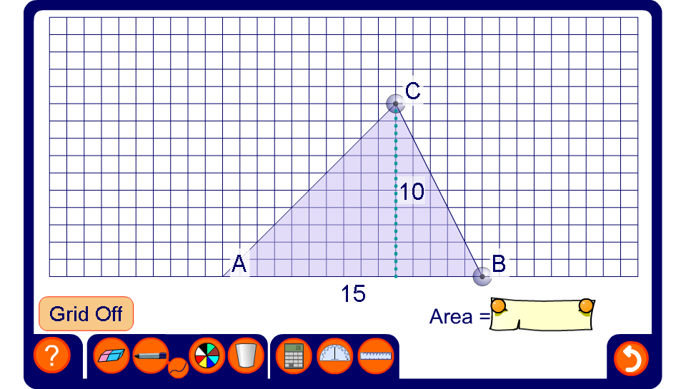


The area of a triangle
Notes:
Modify the triangle to change its height and its width.
If required use the pen tool to draw a rectangle around the triangle to justify its formula.
The square grid can be turned off once the derivation of the formula has been established.
As an extension activity discuss how we could use Pythagoras’ Theorem to calculate the perimeter of the triangle.

